Slide 1

云网超融合四川省工程研究团队
电子科技大学
Networking Lab, UESTC
Email：wangwy@uestc.edu.cn

Slide 2
汇报内容
1、实验室简介
2、代表性工作
3, 区块链

Slide 3
PART 1 实验室简介

Slide 4

研究团队
Wang Wenyong [教授、博导、洪堡学者]
计算机科学与技术学院网络实验室主任
研究方向：区块链、深度学习、网络
论文发表:
He has been committed to the basic theory and Application Research of network security and blockchain. In recent years, he has published high-level academic papers in international academic journals and conferences in the field of blockchain and network security, including CCF a conferences.
Recently he has National Science Project For Data fusion techniques and baggage/ luggage tracing using blockchain and RDIF technology.

Slide 5
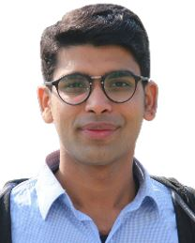
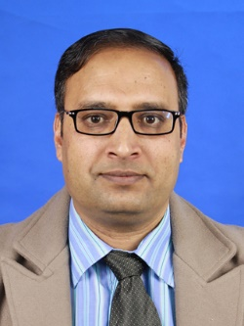
RAJESH KUMAR、副研究员
从事区块链和网络安全研究。博士毕业于电子科技大学 ，在国际会议期刊发表高水平学术论文40余篇
骨干成员
RIAZ-ULLAH KHAN 副研究员
从事区块链和网络安全基础研究，国内外学术刊物及学术会议上发表专业论文40余篇，主编及参编专业课程教材3本；主研重庆市教委课题1项；主持精品资源在线开放课程1门；获得软件著作权2项。指导学生获得大数据技术与应用专业赛项国赛二等奖等。
骨干成员

Slide 6
上三个月
1. Blockchain-Federated-Learning and Deep Learning Models for COVID-19 Detection
Using CT Imaging (IEEE SENSORS JOURNAL)
Making assembly line in supply chain robust and secure using UHF RFID and blockchain (Scientific Report)
Context-aware Bidirectional Neural Model for Sindhi Named Entity Recognition (Applied Science)

Slide 7
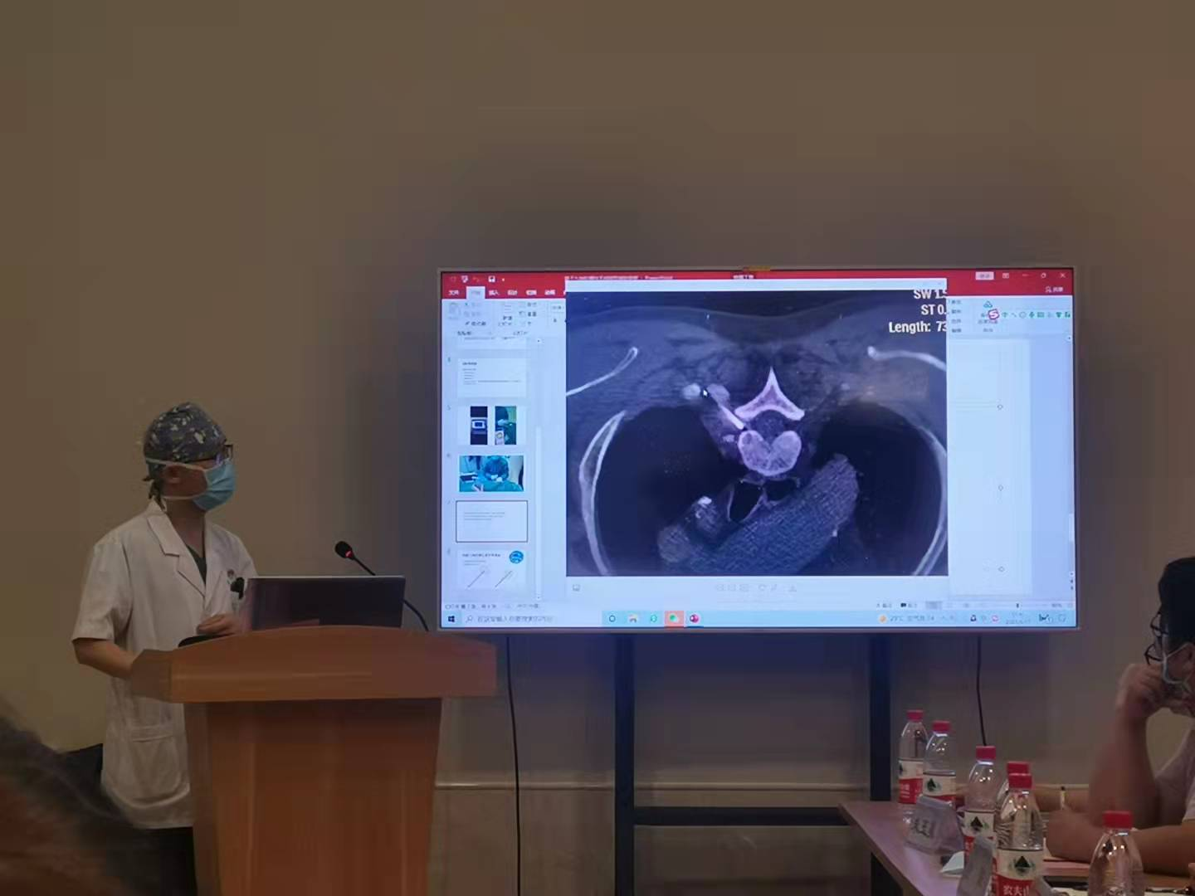
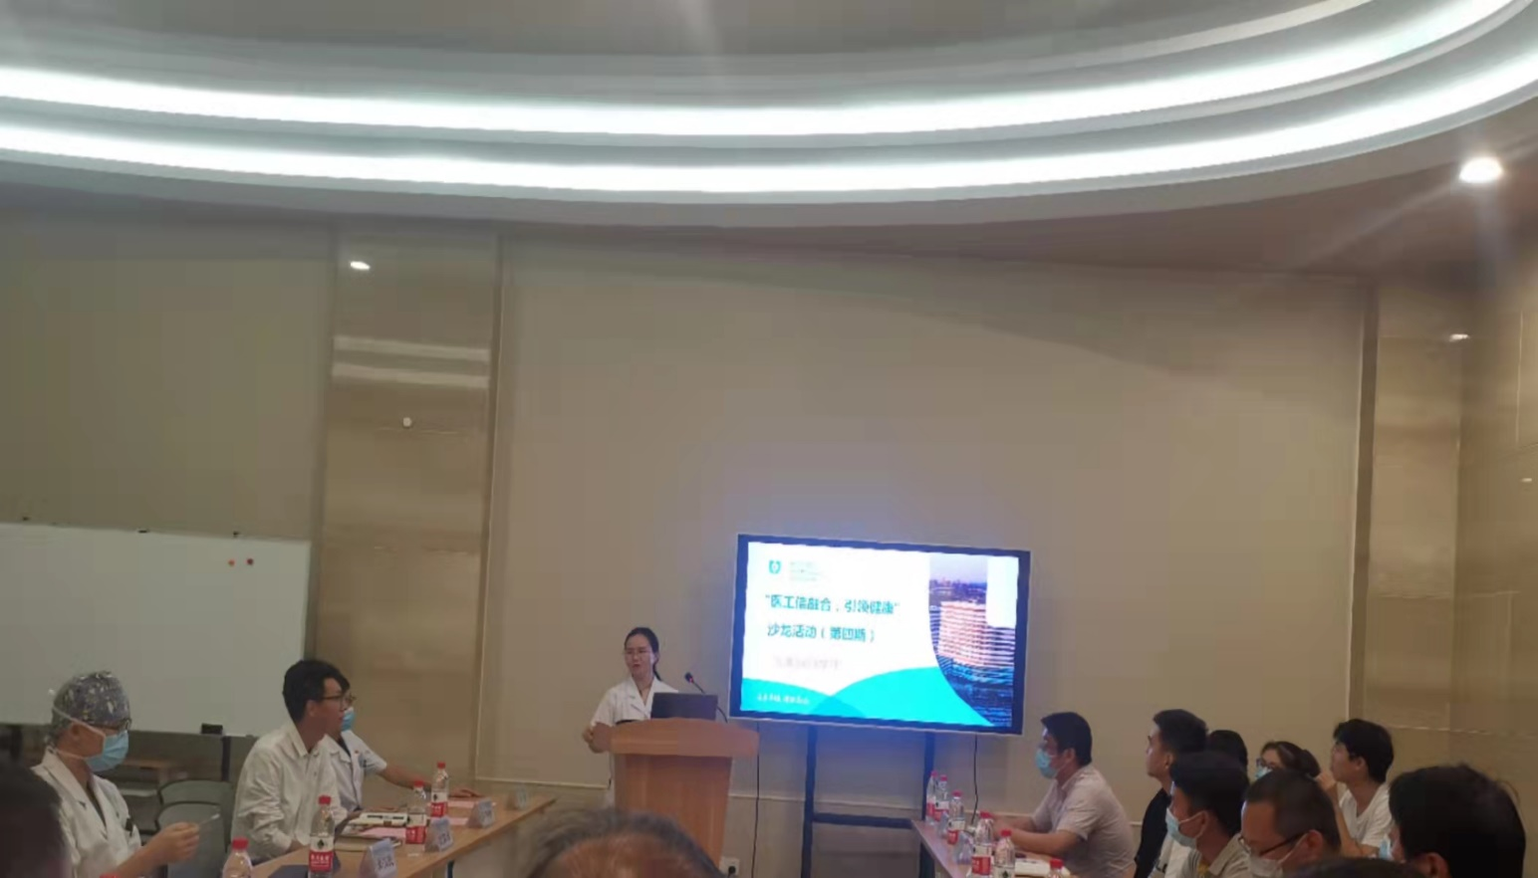
Collaboration with Hospital

Slide 8
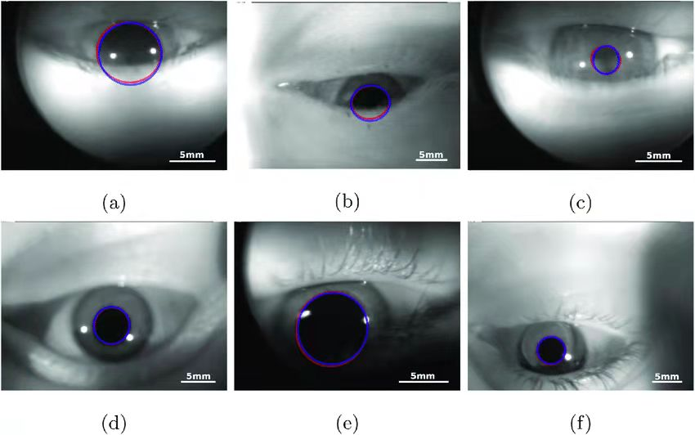
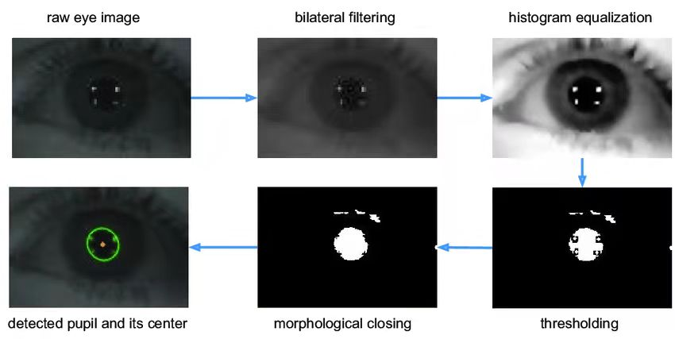

Slide 9

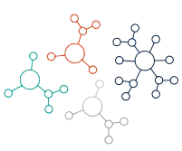


Introduction
AI has a tremendous potential in the health care sectors
More the data better our IA system is
Health data nature is private
Data of Rare or emerging disease is less
How to increase machine learning model accuracy without sharing data
Give me data
Hospital
Output
Database
Patterns
We cannot share
We need more data

Slide 10
Introduction
Federated Learning (FL)
A way of decentralize learning
No data is needed for sharing
Model is shared
Google Keyboard (Gboard)
Medical Data Analysis as Use-case for FL
Hospitals can train local models
Models will be aggregated in the
No need to for actual data
Give me neural model
Local Learned Models
10

Slide 11
3
Blockchain-Federated-Learning and Deep Learning Models for COVID-19 Detection Using CT Imaging
in IEEE Sensors Journal, 2021

Slide 12

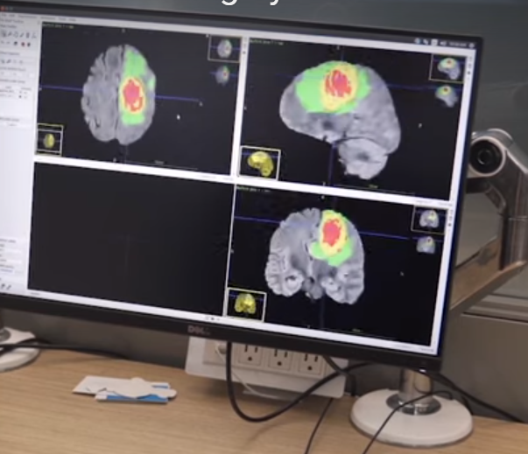
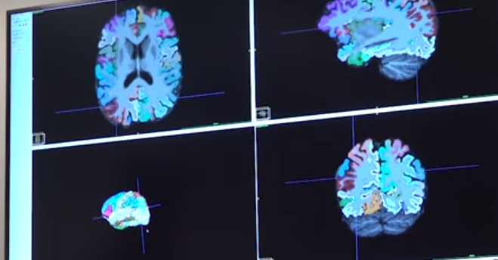
Motivation

Slide 13
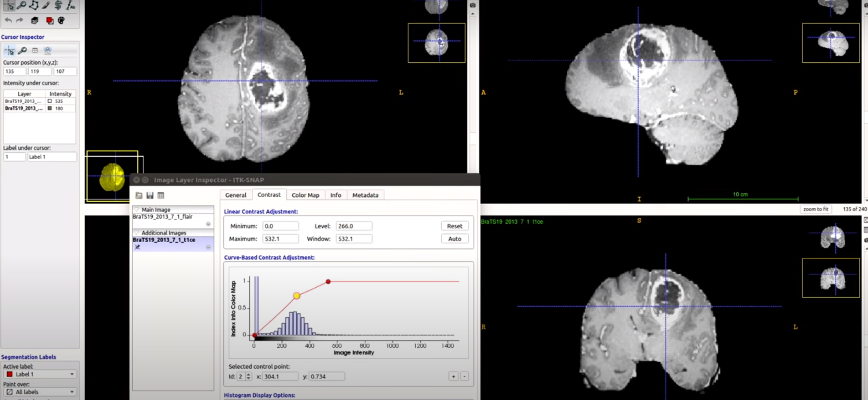
Results

Slide 14
Motivation
To solve the limited communication
Intermittent compute node availability
Intermittent data availability
Massively distributed
Privacy preserving aggregation
Traceability & interpretability to understand which data points were key to the predication and accuracy of the model

Slide 15
Motivation
Spread of Covid-19 was rapid
Coronavirus triggers an acute respiratory infection in the lungs
Initially severe cases were detected through CT Scans Images
nucleic acid test were less accurate and lack of testing kits
Doctors needed urgent training
Each Hospital have less data / no data
Challenges
Data heterogeneity due to machine configurations
Shared model reliability
Data Privacy
?
Local Learned Models
15

Slide 16
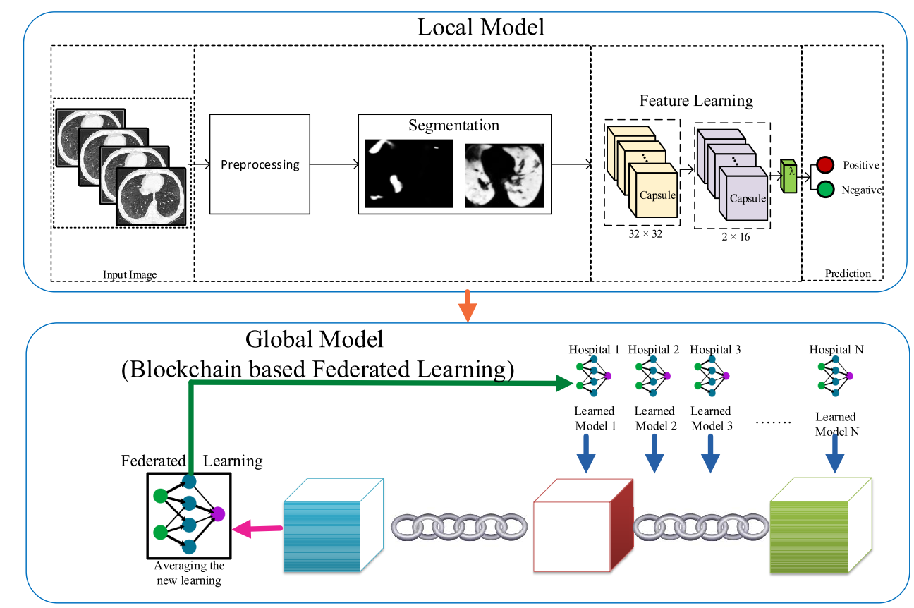
Proposed Model
Hospital Train Local Model
Local Model is capsule Neural network
Blockchain is traces the local model and ensure reliability through smart contract
16

Slide 17
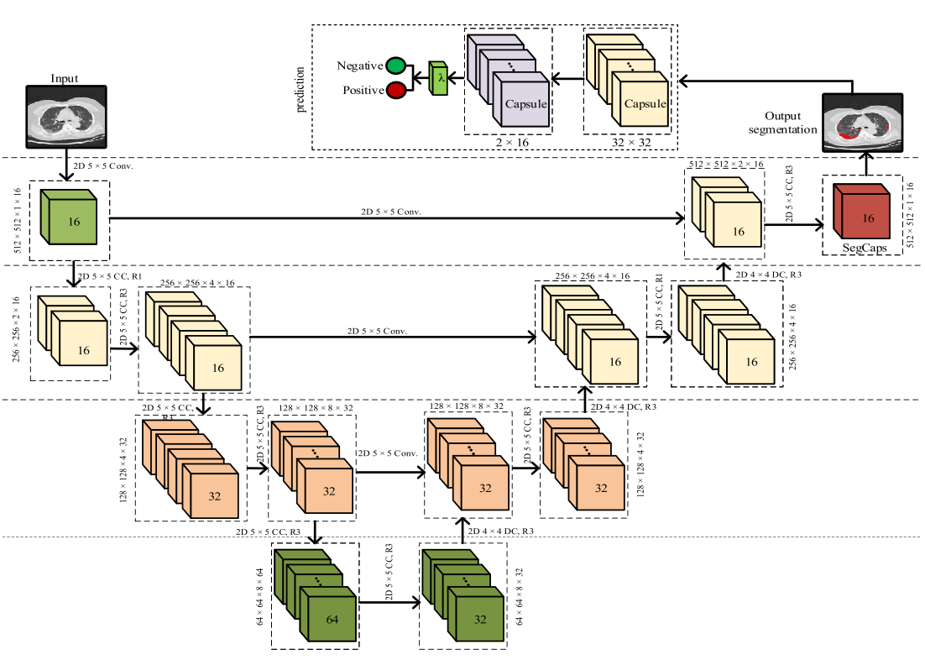
Proposed Model
Capsule Network
Split the image into segments
Learn convolutional network
17

Slide 18
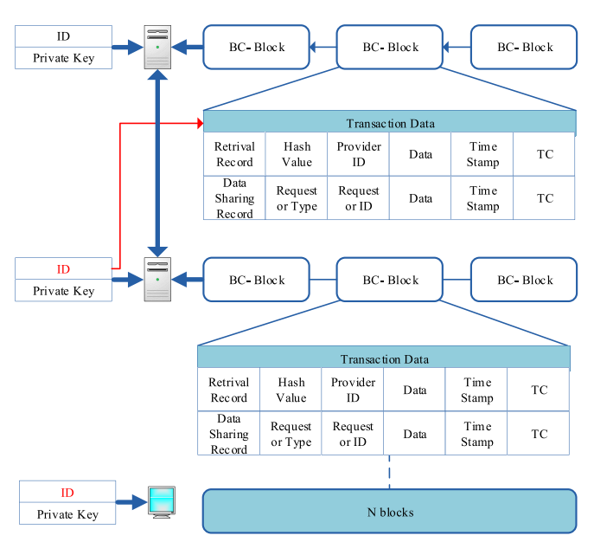
Blockchain
Stores transactions (in blocks) in Decentralized way
Transaction Traceability
Store weights of models of hospitals
18

Slide 19
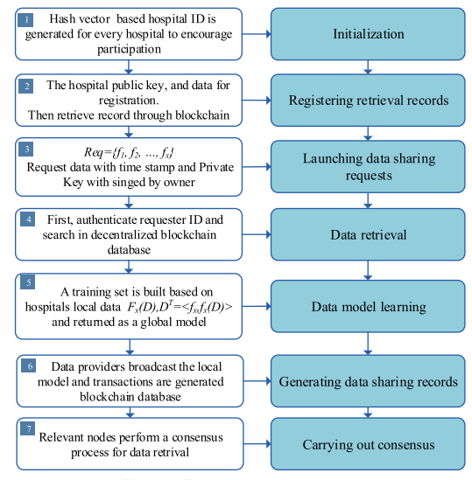
Data Sharing Process
19

Slide 20
Federated Learning Steps
20

Slide 21
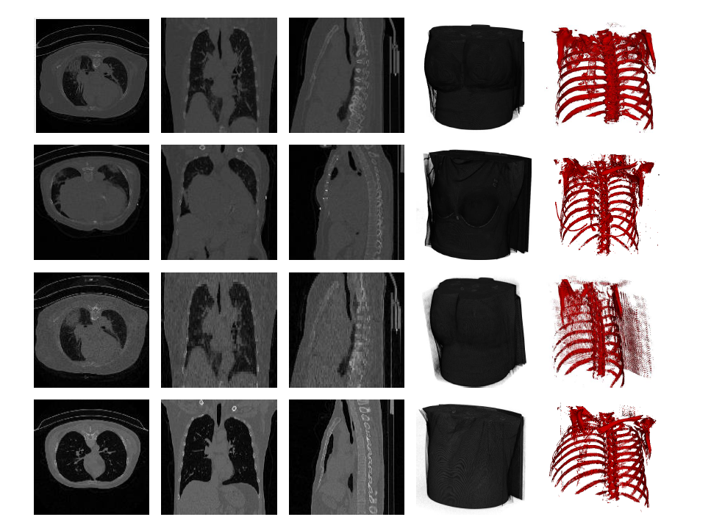
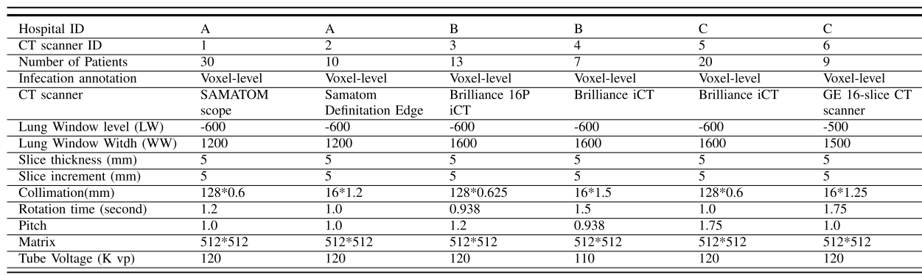
Dataset
CT Scan Images Data Collection
3 Hospitals of Chengdu City (China)
89 Subjects
Each hospital has two CT Scan Imaging machines
21

Slide 22
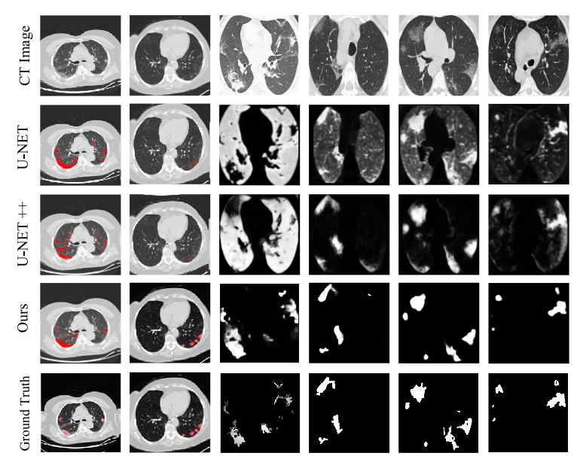
Segmentation Comparison with SOTA
22

Slide 23
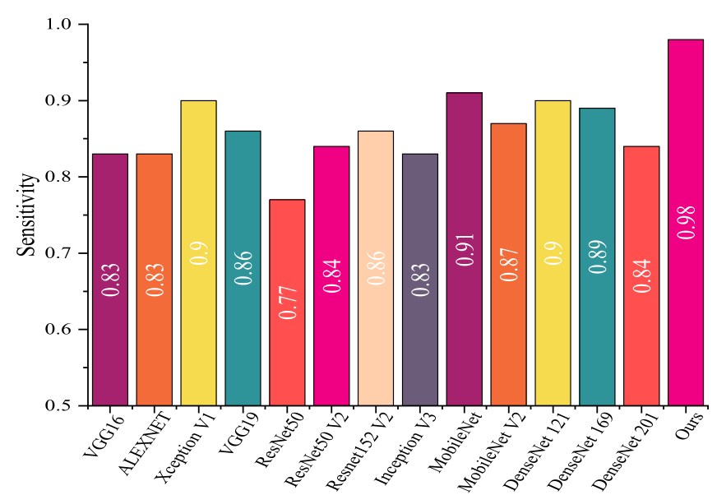
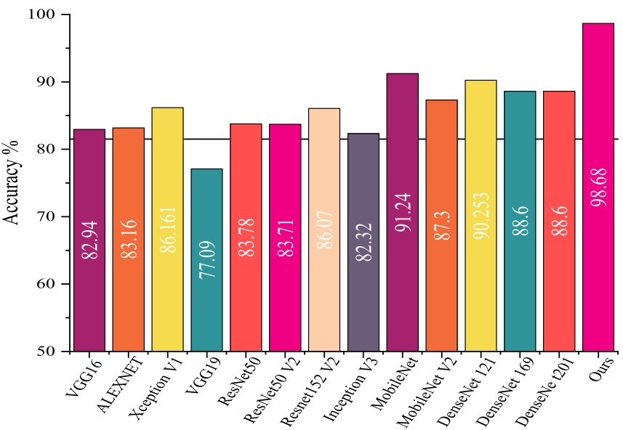
Performance Comparison
23

Slide 24
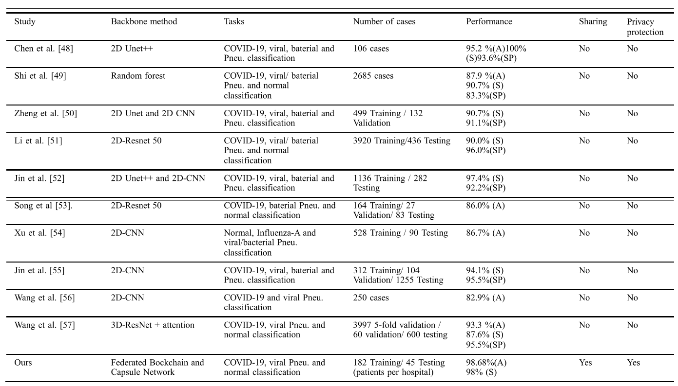
Performance Comparison
24

Slide 25
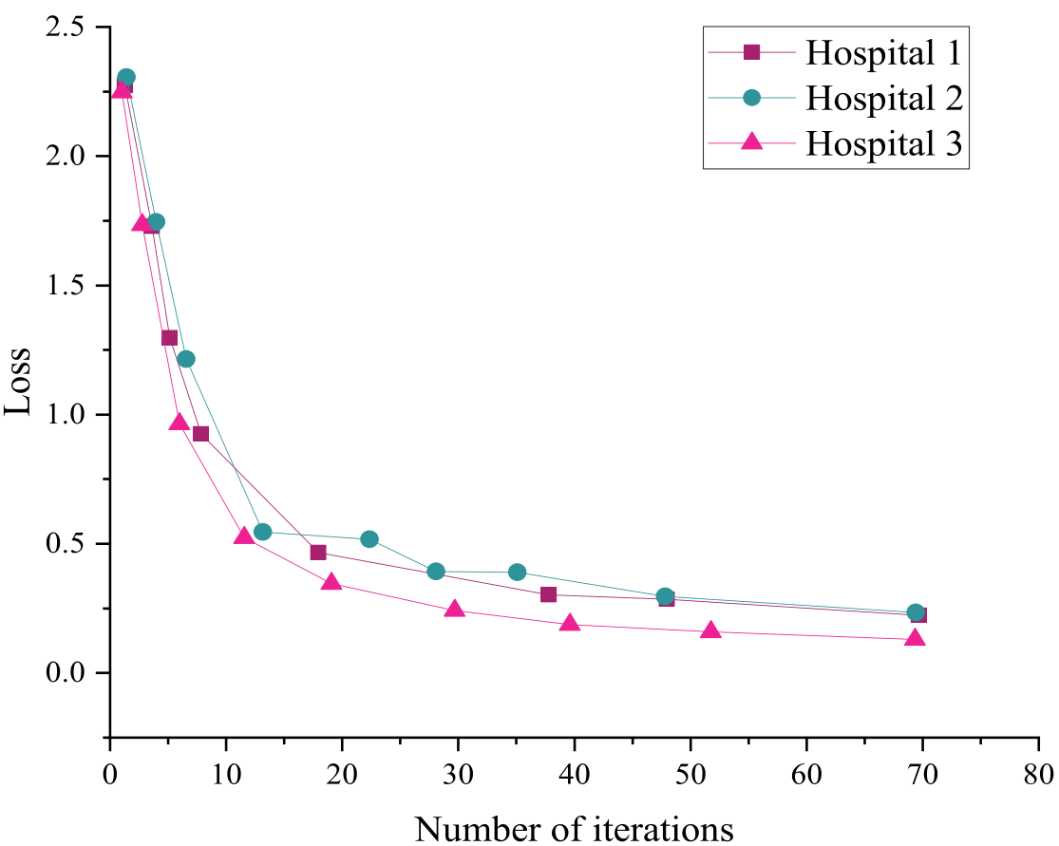
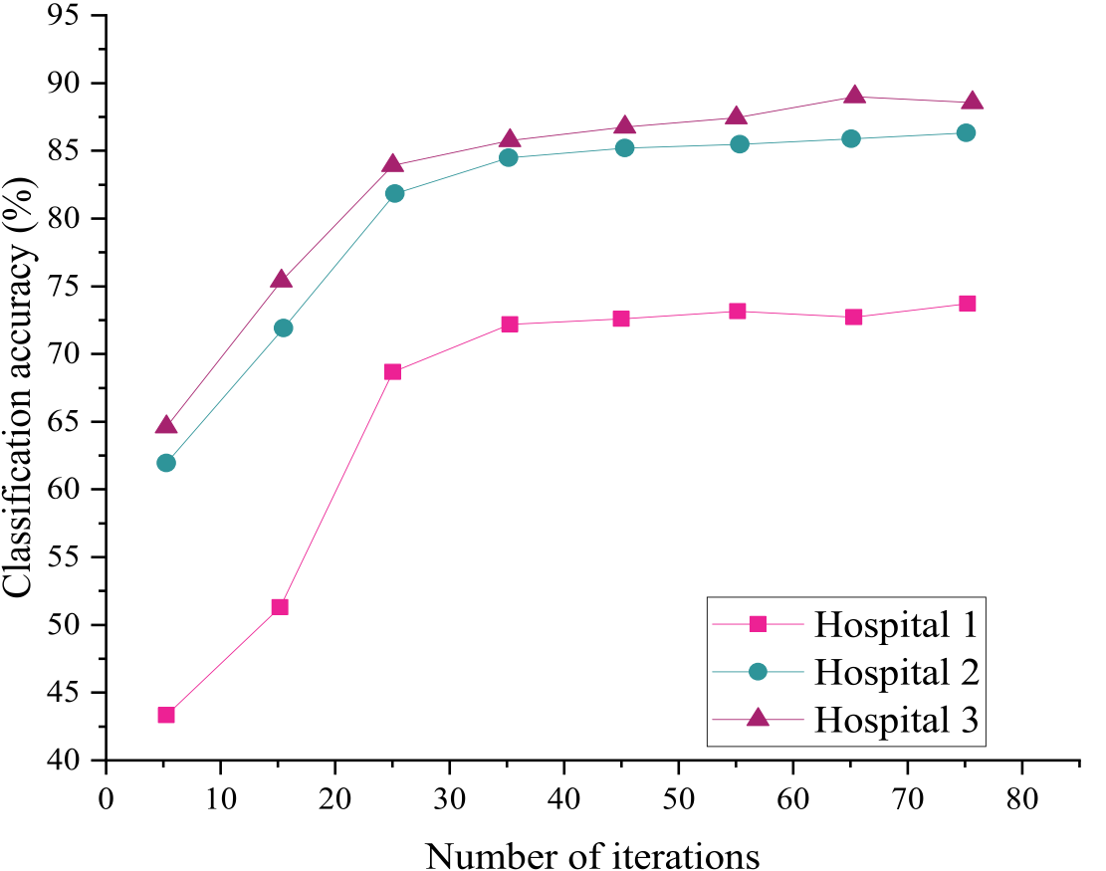
Performance Comparison
25

Slide 26
Part 2 代表性工作
Introduction
Federated Learning
Results
Motivation
Research Methodology in more detail

Slide 27
Introduction
AI has a tramadol potential in the health care sectors for the diagnosis of the best treatments and drugs.
We give enough data to an algorithm to learn the model•Health data nature is private. That includes the information we do not want to share
Thus, it is very difficult to take out the hospital and pull it in one place
The new method is developed called federated learning
Where instead of data to the model, We take the model out of the data.

Slide 28
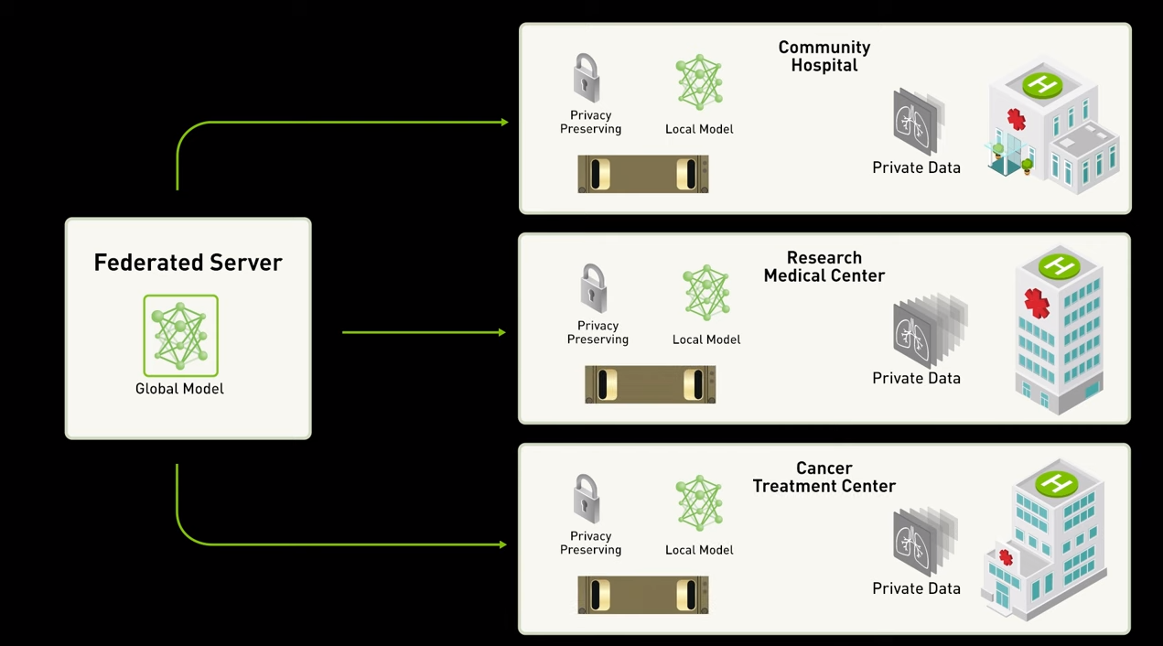
Federated Learning

Slide 29
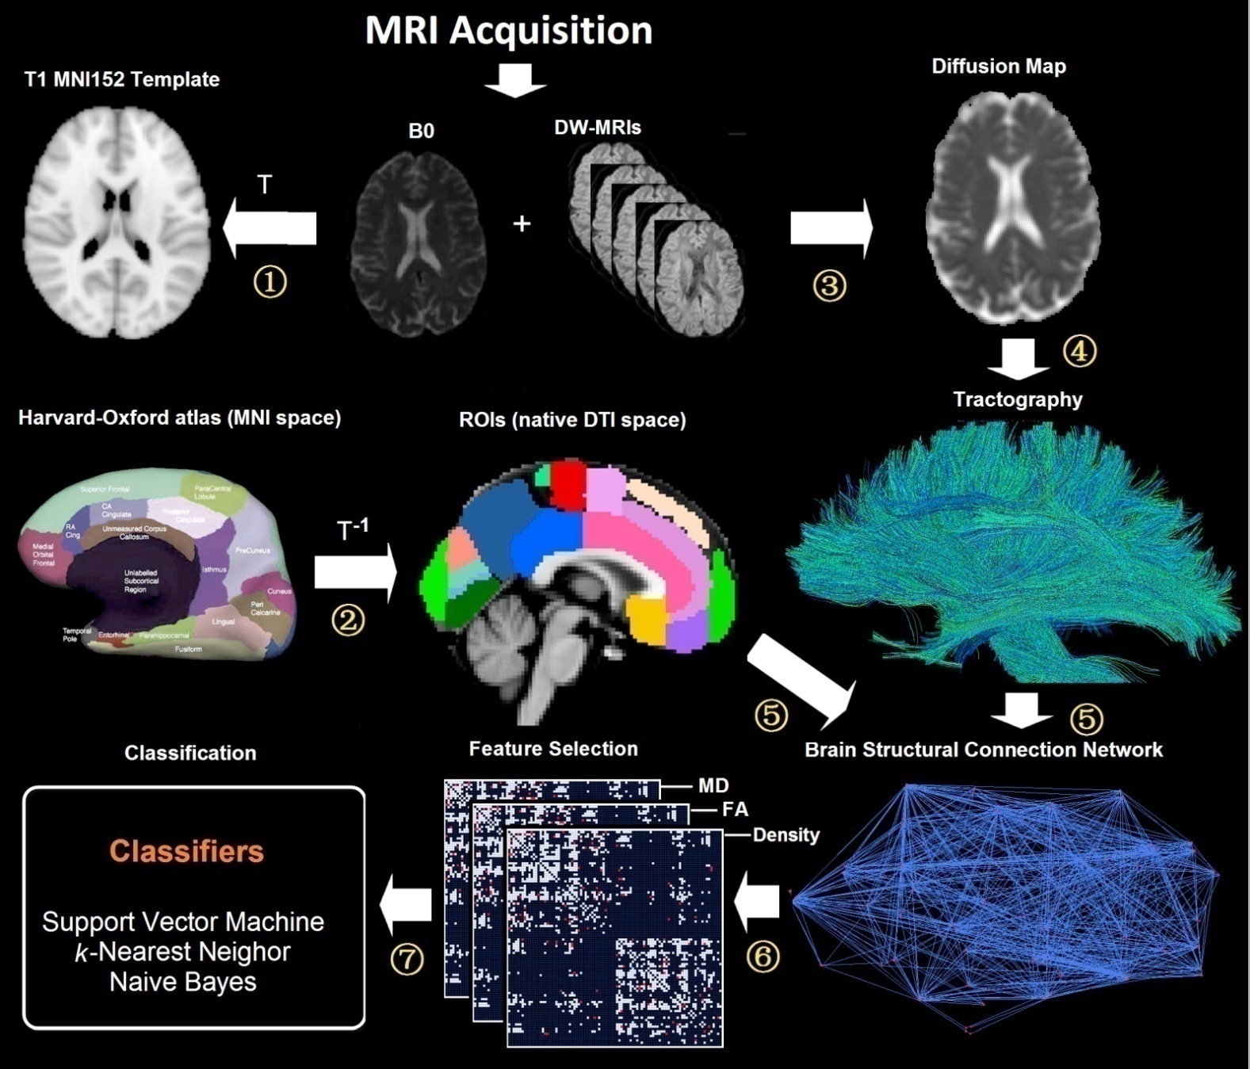
It is proposed to analyze by extracting different network topology connection patterns.
image registration
Gray matter segmentation
Dispersion tensor calculation
Fiber tracking
Reconstructing brain network
Feature screening
Classification / forecast

Slide 30
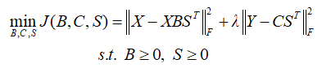

Slide 31
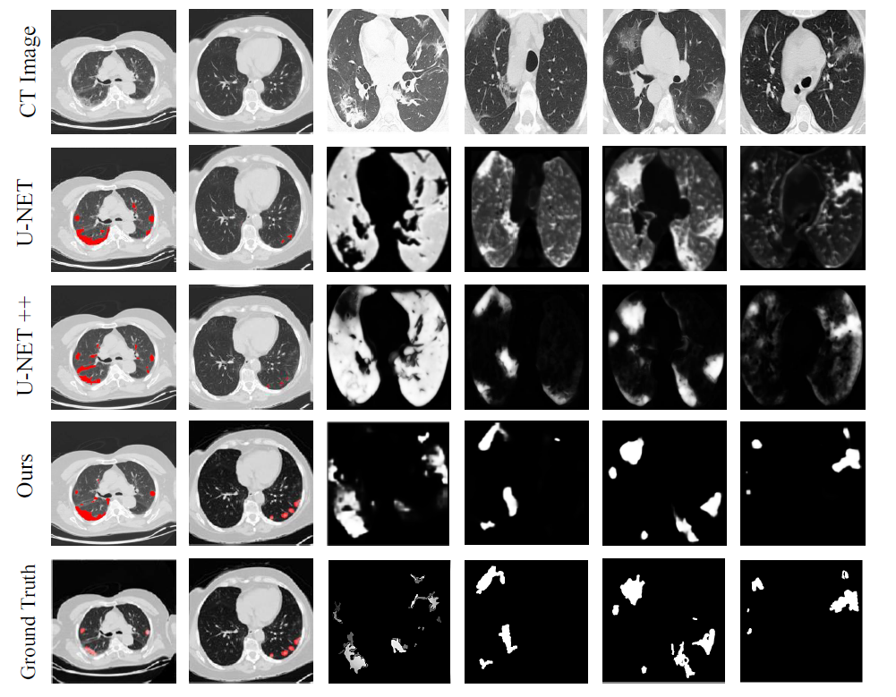
Segmentation Results

Slide 32
PART 3 区块链

Slide 33
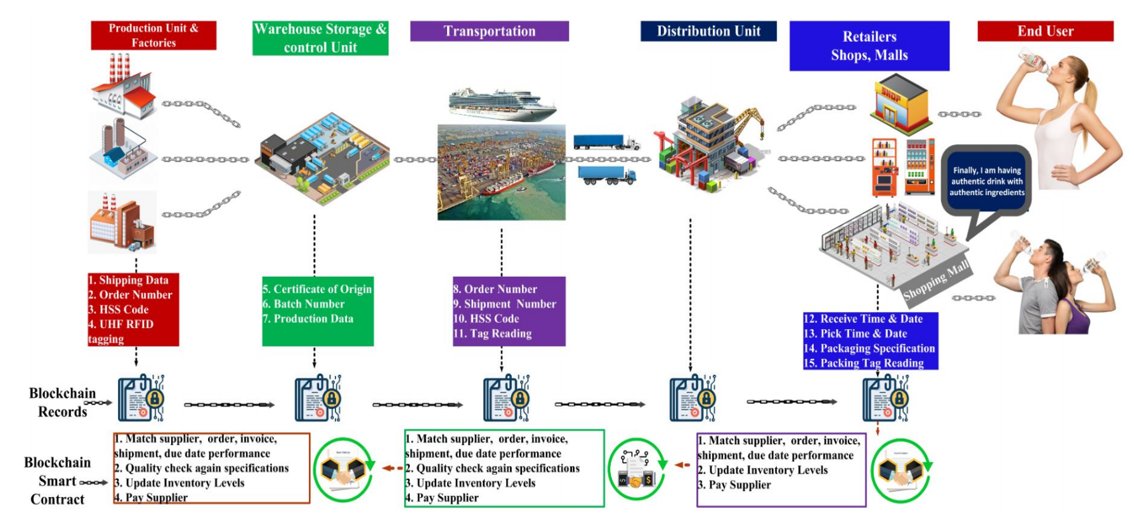
Making assembly line in supply chain robust and
secure using UHF RFID and blockchain

Slide 34
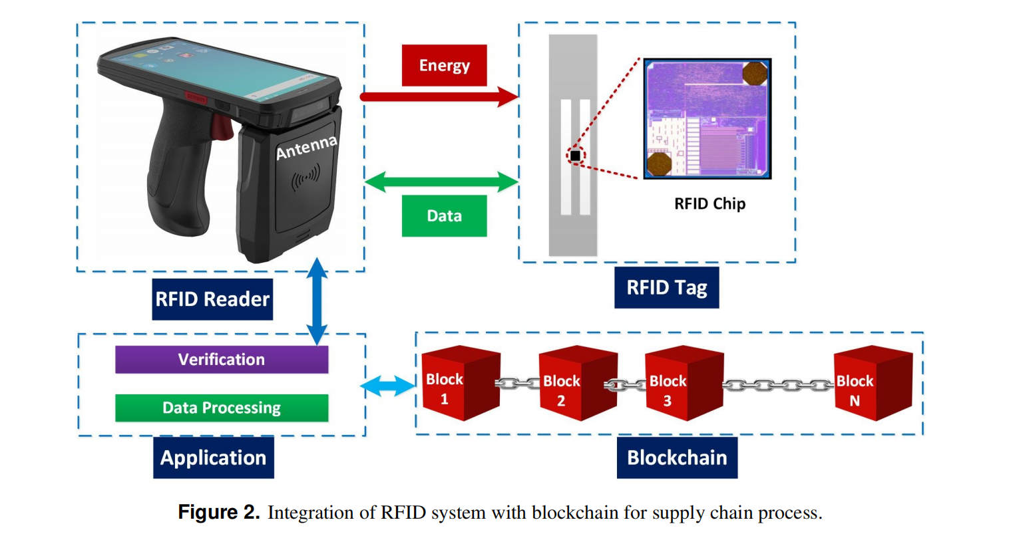

Slide 35
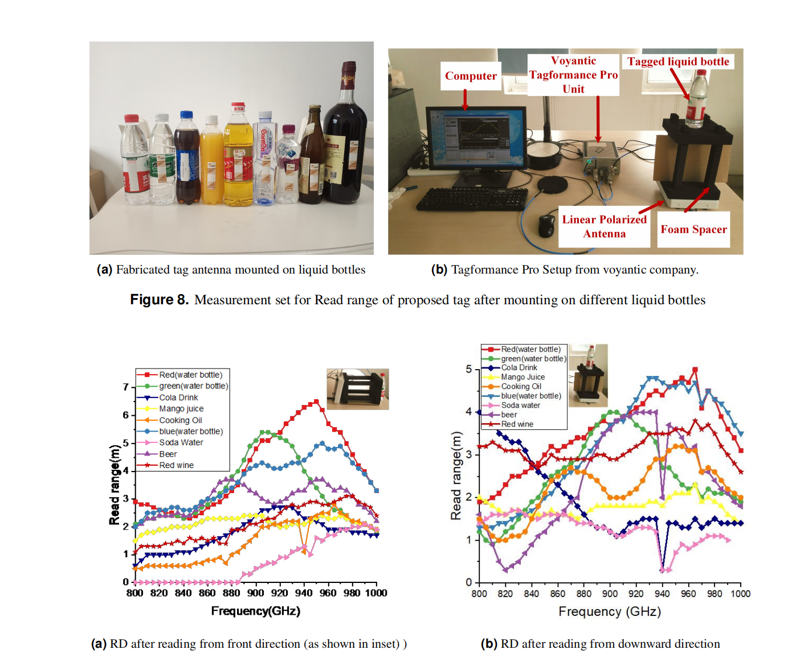

Slide 36
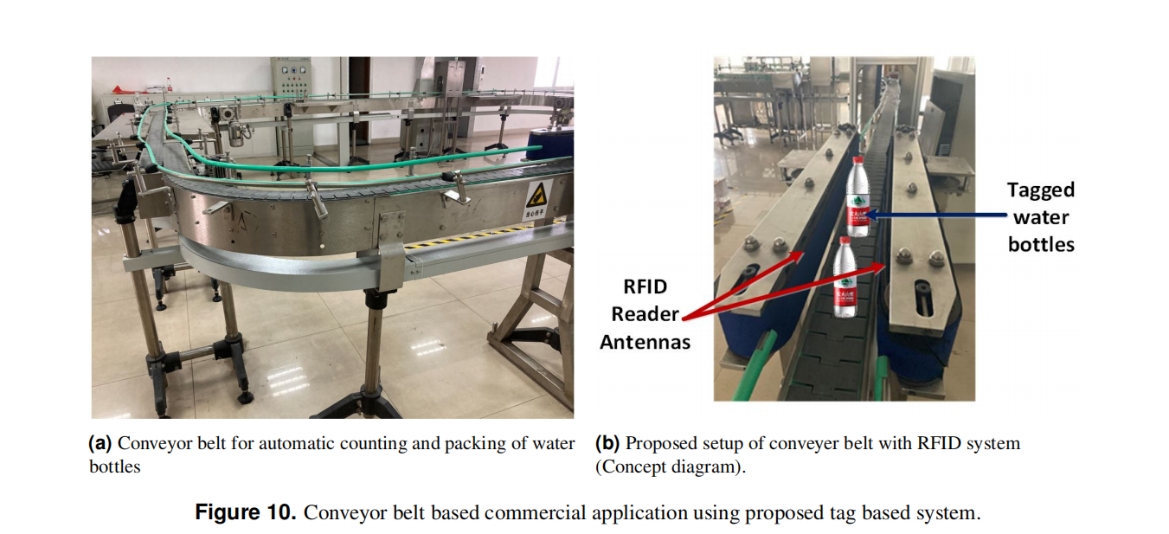
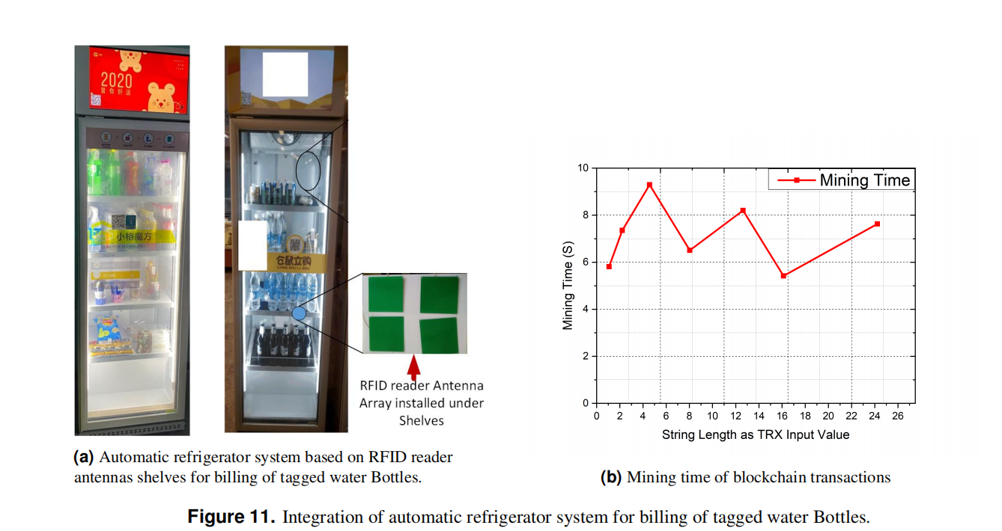

Slide 37
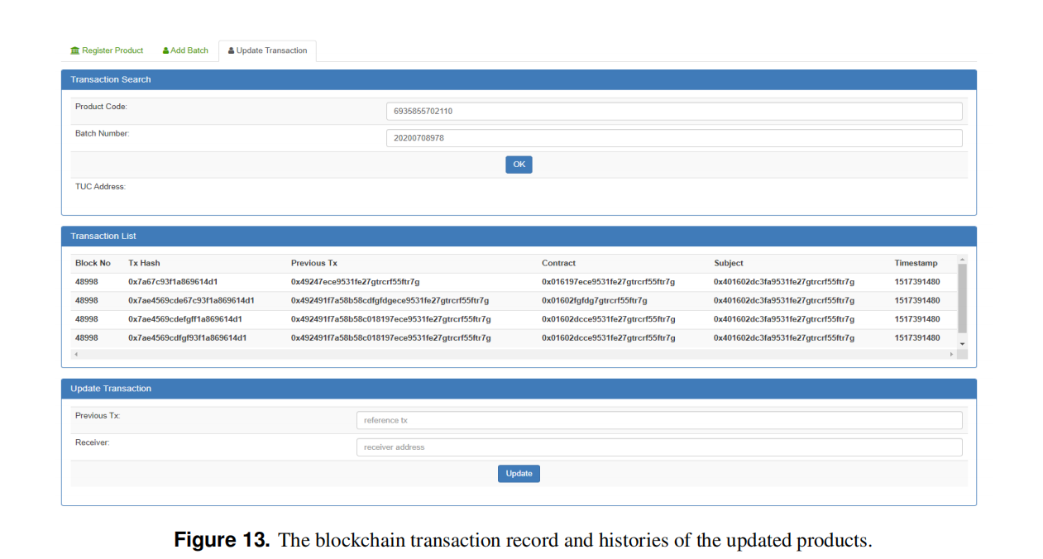

Slide 38


Acknowledgments
First of all, I would like to thank Chinese Government to give me an opportunity to reseach in a high-class reseach institute (UESTC-YDRI). Thanks to Huzhou goverment for giving us space in its heart.
I would like to thank all HR and Fiancé Stuff for their moral support and kind bhaviour.

Slide 39
Acknowledgement
I would like to thank Chinese government accepting me in this research institute, and thanks for Zhejiang government
I also would like to thanks my supervisor Wang Wenyong for their encouragement
Finally, I would to thanks YDRI institute stuff. They are very friendly and kind.
Chinese Government
my friends, labmates and UESTC staff
Wang wen yong

Slide 40
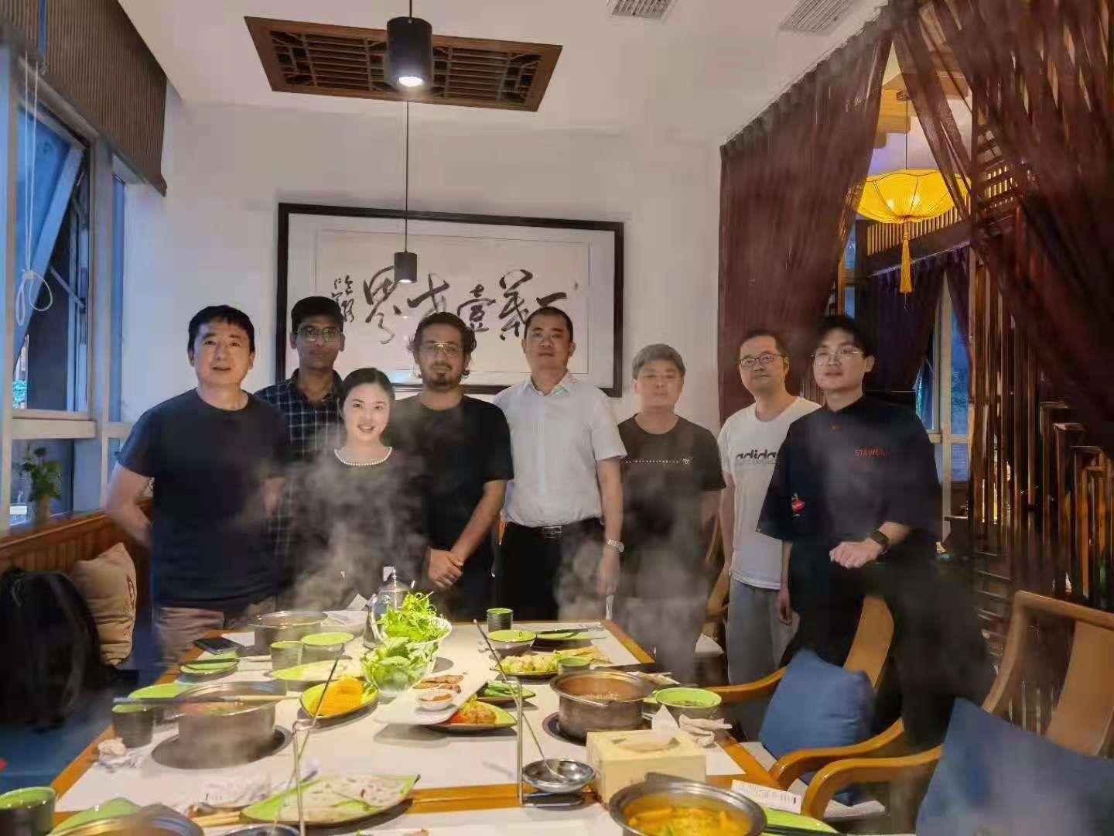
数据挖掘实验室（uestc.edu.cn）
联系人：Wang Wenyong
Email: wangwy@uestc.edu.cn
电话： 13908014292
实验室网站：uestc.edu.cn

Slide 41
谢谢大家！

